Slide 1

CHAPTER 06 ALGORITHMS AND FLOW CHARTS
XI
Computer Science (083)
Board : CBSE
Unit 1:
Computer Systems and Organisation (CSO)

Slide 2

Unit 1:
XI
Computer Science (083)
Board : CBSE
Computer Systems and Organisation (CSO)
Courtesy CBSE

Slide 3

Unit I
Computer Systems and Organisation (CSO)
10 Theory + 02 Practical)
Prepared by
Praveen M Jigajinni
DCSc & Engg, PGDCA,ADCA,MCA.MSc(IT),Mtech(IT),MPhil (Comp. Sci)
Department of Computer Science, Sainik School Amaravathinagar
Cell No: 9431453730
Courtesy CBSE

Slide 4
PROBLEM SOLVING TECHNIQUES

Slide 5
ALGORITHM AND FLOW CHART
OBJECTIVES
able to define problem;
able to define algorithm;
write algorithms for simple problems;
explain properties of an algorithm;
the meaning of flowchart;
explain the need of flow chart;
explain different symbols used in flow chart;
draw flow chart for simple problems; and convert a flow chart into an algorithm and vice versa.

Slide 6
ALGORITHM AND FLOW CHART
INTRODUCTION
Intelligence is one of the key characteristics which differentiate a human being from other living creatures on the earth. Basic intelligence covers day to day problem solving and making strategies to handle different situations which keep arising in day to day life.

Slide 7
ALGORITHM AND FLOW CHART
INTRODUCTION
One person goes Bank to withdraw money. After knowing the balance in his account, he/she decides to withdraw the entire amount from his account but he/she has to leave minimum balance in his account.

Slide 8
ALGORITHM AND FLOW CHART
INTRODUCTION
Here deciding about how much amount he/she may withdraw from the account is one of the example of the basic intelligence. During the process of solving any problem, one tries to find the necessary steps to be taken in a sequence.

Slide 9
ALGORITHM AND FLOW CHART
What is Algorithm?
Algorithm can be defined as: “A sequence of activities to be processed for getting desired output from a given input.”

Slide 10
ALGORITHM AND FLOW CHART
What is Algorithm?
Webopedia defines an algorithm as:
“A formula or set of steps for solving a
particularproblem. To be an algorithm, a set of rules must be unambiguous and have a clear stopping point”.

Slide 11
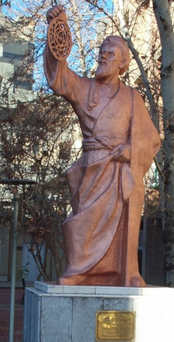
MUHAMMAD IBN MUSA AL-KHWARIZMI
Muḥammad ibn Mūsā al-Khwārizmī (Persian: محمد بن موسى خوارزمی‎; c. 780 – c. 850), Formerly Latinized as Algoritmi, was a Persian scholar who produced works in mathematics, astronomy, & geography under the patronage of the Caliph Al-Ma'mun of the Abbasid Caliphate.
Around 820 AD he was appointed as the astronomer and head of the library of the House of Wisdom in Baghdad.

Slide 12
PROPERTIES OF ALGORITHM
Donald Ervin Knuth has given a list of five properties for an algorithm, these properties are:
FINITENESS
DEFINITENESS
INPUT
OUTPUT
EFFECTIVENESS

Slide 13
PROPERTIES OF ALGORITHM
FINITENESS:
An algorithm must always terminate after a finite number of steps. It means after every step one reach closer to solution of the problem and after a finite number of steps algorithm reaches to an end point.

Slide 14
PROPERTIES OF ALGORITHM
2) DEFINITENESS
Each step of an algorithm must be precisely defined. It is done by well thought actions to be performed at each step of the algorithm. Also the actions are defined unambiguously for each activity in the algorithm.

Slide 15
PROPERTIES OF ALGORITHM
3) INPUT
Any operation you perform need some beginning value/quantities associated with different activities in the operation. So the value/quantities are given to the algorithm before it begins.

Slide 16
PROPERTIES OF ALGORITHM
4) OUTPUT:
One always expects output/result (expected value/quantities) in terms of output from an algorithm. The result may be obtained at different stages of the algorithm. If some result is from the intermediate stage of the operation then it is known as intermediate result and result obtained at the end of algorithm is known as end result. The output is expected value/quantities always have a specified relation to the inputs.

Slide 17
PROPERTIES OF ALGORITHM
5) EFFECTIVENESS:
Algorithms to be developed/written using basic operations. Actually operations should be basic, so that even they can in principle be done exactly and in a finite amount of time by a person, by using paper and pencil only.

Slide 18
PROPERTIES OF ALGORITHM
Any algorithm should have all these five properties otherwise it will not fulfil the basic objective of solving a problem in finite time. As you have seen in previous examples, every step of an algorithm puts you closer to the solution

Slide 19
ALGORITHM EXAMPLES
Let us take one simple day-to-day example by writing algorithm for making, “Maggi Noodles‟ as a food.
Step 1: Start
Step 2: Take pan with water
Step 3: Put pan on the burner
Step 4: Switch on the gas/burner
Step 5: Put magi and masala
Step 6: Give two minutes to boil
Step 7: Take off the pan
Step 8: Take out the magi with the help of
fork/spoon
Step 9: Put the maggi on the plate and serve it
Step 10: Stop.

Slide 20
ALGORITHM EXAMPLES
Write an algorithm to print “Good Morning‟
Step 1: Start
Step 2: Print “Good Morning‟
Step 3: Stop

Slide 21
ALGORITHM EXAMPLES
Write an algorithm to find area of a rectangle.
Step 1: Start
Step 2: Take length and breadth and
store them as L and B?
Step 3: Multiply by L and B and store it
in area
Step 4: Print area
Step 5: Stop

Slide 22
ALGORITHM EXAMPLES
Write an algorithm to check whether he is eligible to vote? (more than or equal to 18
years old).
Step 1: Start
Step 2: Take age and store it in age
Step 3: Check age value, if age >= 18 then go to step 4 else step 5
Step 4: Print “Eligible to vote” and go to
step 6
Step 5: Print “Not eligible to vote”
Step 6: Stop

Slide 23
ALGORITHM EXAMPLES
Write an algorithm to check whether given number is +ve, -ve or zero.
Step 1: Start
Step 2: Take any number and store it in n.
Step 3: Check n value, if n > 0 then go to
step 5 else go to step 4
Step 4: Check n value, if n < 0 then go to
step 6 else go to step 7

Slide 24
ALGORITHM EXAMPLES
Write an algorithm to check whether given number is +ve, -ve or zero.
Step 5: Print “Given number is +ve”and go
to step 8
Step 6: Print “Given number is -ve” and go
to step 8
Step 7: Print “Given number is zero”
Step 8: Stop

Slide 25
FLOWCHART

Slide 26
The flowchart is a diagram which visually presents the flow of data through processing systems. This means by seeing a flow chart one can know the operations performed and the sequence of these operations in a system. Algorithms are nothing but sequence of steps for solving problems. So a flow chart can be used for representing an algorithm. A flowchart, will describe the operations (and in what sequence) are required to solve a given problem.
FLOWCHART

Slide 27
A flowchart is a type of diagram that represents an algorithm, workflow or process. The flowchart shows the steps as boxes of various kinds, and their order by connecting the boxes with arrows. This diagrammatic representation illustrates a solution model to a given problem. Flowcharts are used in analyzing, designing, documenting or managing a process or program in various fields.
FLOWCHART

Slide 28
BUILDING BLOCKS OF FLOW CHART OR COMMON SYMBOLS OF FLOW CHART

Slide 29
The American National Standards Institute (ANSI) set standards for flowcharts and their symbols in the 1960s. The International Organization for Standardization(ISO) adopted the ANSI symbols in 1970. The current standard was revised in 1985. Generally, flowcharts flow from top to bottom and left to right.
BUILDING BLOCKS OF FLOW CHART

Slide 30
BUILDING BLOCKS OF FLOW CHART
ANSI/ISO Shape | Name | Description
 | Flowline (Arrowhead) | Shows the process's order of operation. A line coming from one symbol and pointing at another. Arrowheads are added if the flow is not the standard top-to-bottom, left-to right.

Slide 31
BUILDING BLOCKS OF FLOW CHART
ANSI/ISO Shape | Name | Description
 | Terminal | Indicates the beginning and ending of a program or sub-process. Represented as a stadium, oval or rounded (fillet) rectangle. They usually contain the word "Start" or "End", or another phrase signaling the start or end of a process, such as "submit inquiry" or "receive product".

Slide 32
BUILDING BLOCKS OF FLOW CHART
ANSI/ISO Shape | Name | Description
 | Process | Represents a set of operations that changes value, form, or location of data. Represented as a rectangle

Slide 33
BUILDING BLOCKS OF FLOW CHART
ANSI/ISO Shape | Name | Description
 | Decision | Shows a conditional operation that determines which one of the two paths the program will take. The operation is commonly a yes/no question or true/false test. Represented as a diamond (rhombus).

Slide 34
BUILDING BLOCKS OF FLOW CHART
ANSI/ISO Shape | Name | Description
 | Input / Output | Indicates the process of inputting and outputting data, as in entering data or displaying results. Represented as a parallelogram

Slide 35
BUILDING BLOCKS OF FLOW CHART
ANSI/ISO Shape | Name | Description
 | Annotation (Comment) | Indicating additional information about a step the program. Represented as an open rectangle with a dashed or solid line connecting it to the corresponding symbol in the flowchart.

Slide 36
BUILDING BLOCKS OF FLOW CHART
ANSI/ISO Shape | Name | Description
 | Predefined Process Functions | Shows named process /Function which is defined elsewhere. Represented as a rectangle with double-struck vertical edges.

Slide 37
BUILDING BLOCKS OF FLOW CHART
ANSI/ISO Shape | Name | Description
 | On-page Connector | Pairs of labelled connectors replace long or confusing lines on a flowchart page. Represented by a small circle with a letter inside.

Slide 38
BUILDING BLOCKS OF FLOW CHART
ANSI/ISO Shape | Name | Description
 | Off-page Connector | A labelled connector for use when the target is on another page. Represented as a home plate-shaped pentagon.

Slide 39
BUILDING BLOCKS OF FLOW CHART
ANSI/ISO Shape | Name | Description
 | Storage/Backup | Magnetic Tape used for secondary storage/Backup

Slide 40
BUILDING BLOCKS OF FLOW CHART
ANSI/ISO Shape | Name | Description
 | Storage/Backup | Magnetic Disk used for secondary storage/Backup

Slide 41
ADVANTAGES OF USING FLOWCHARTS
As we discussed flow chart is used for representing algorithm in pictorial form. This pictorial representation of a solution/system is having many advantages. These advantages are as follows:
COMMUNICATION.
EFFECTIVE ANALYSIS.
DOCUMENTATION OF PROGRAM/SYSTEM.
EFFICIENT PROGRAM MAINTENANCE.
CODING OF THE PROGRAM.

Slide 42
ADVANTAGES OF USING FLOWCHARTS
COMMUNICATION:
A Flowchart can be used as a better way of communication of the logic of a system and steps involve in the solution, to all concerned particularly to the client of system.

Slide 43
ADVANTAGES OF USING FLOWCHARTS
EFFECTIVE ANALYSIS:
A flowchart of a problem can be used for effective analysis of the problem.

Slide 44
ADVANTAGES OF USING FLOWCHARTS
3.DOCUMENTATION OF PROGRAM/ SYSTEM:
Program flowcharts are a vital part of a good program documentation. Program document is used for various purposes like knowing the components in the program, complexity of the program etc.

Slide 45
ADVANTAGES OF USING FLOWCHARTS
4. EFFICIENT PROGRAM MAINTENANCE:
Once a program is developed and becomes operational it needs time to time maintenance. With help of flowchart maintenance become easier.

Slide 46
ADVANTAGES OF USING FLOWCHARTS
5. CODING OF THE PROGRAM:
Any design of solution of a problem is finally converted into computer program. Writing code referring the flowchart of the solution become easy.

Slide 47
LIMITATIONS OF USING FLOWCHARTS
COMPLEXITY OF LOGIC: If program logic is complex then flowchart of the program becomes complicated.
2) ALTERATIONS AND MODIFICATIONS IN LOGIC: any alterations in the program logic may require re­drawing of flowchart completely.
3) REUSE IS NOT POSSIBLE: As the flowchart symbols cannot be typed, always reproduction of flowchart symbols are required.

Slide 48
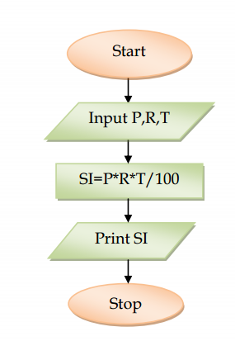
FLOWCHART EXAMPLES
Draw a flowchart to find the simple interest. (Sequence)

Slide 49
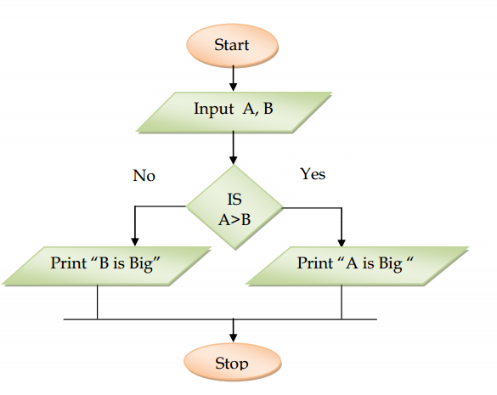
FLOWCHART EXAMPLES
Draw a flowchart to find bigger number among two numbers (selective)

Slide 50
FLOWCHART EXAMPLES
Draw a flow chart to find factorial of any number.

Slide 51
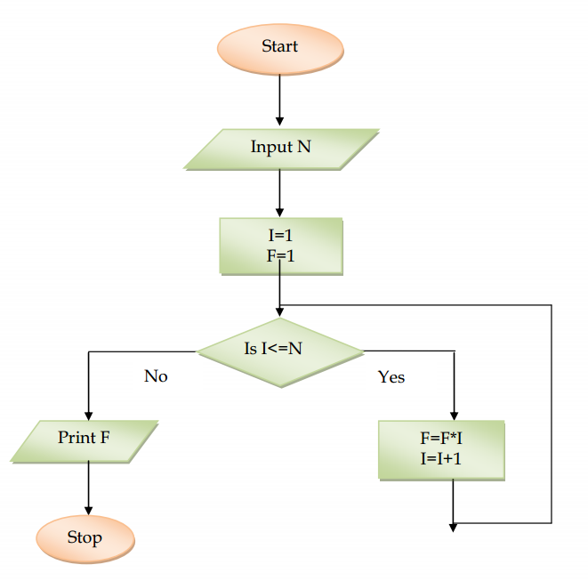
FLOWCHART EXAMPLES

Slide 52
FLOWCHART EXAMPLES
Draw a flow chart to print the number from 1 to N.

Slide 53
FLOWCHART EXAMPLES

Slide 54
FLOWCHART EXAMPLES
Draw a flow chart to find biggest number among N numbers.

Slide 55
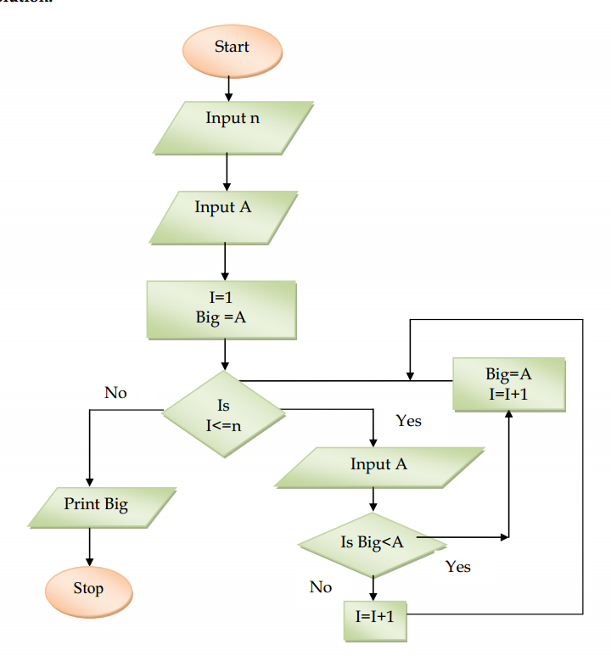
FLOWCHART EXAMPLES

Slide 56
CLASS TEST

Slide 57
MULTIPLE CHOICE QUESTIONS
Time: 40 Min Max Marks 20
1. A step by step method for solving a problem using English Language
(a) program (b) Flowchart
(c) statement (d) Algorithm
Set of statements is executed based upon conditional test.
(a) Looping (b) Selective
(c) Sequence (d) None

Slide 58
MULTIPLE CHOICE QUESTIONS
Set of statements is executed again and again based upon conditional test.
(a) Looping (b) Selective
Sequence (d) None
4. The graphical representation of algorithm is
(a) program (b) Flowchart
(c) statement (d) Algorithm
5. All instructions are executed one after other.
(a) Looping (b) Selective
(c) Sequence (d) None

Slide 59
ANSWER THE FOLLOWING QUESTIONS.
Define Algorithm.
Define Flowchart.
Write an algorithm to find the sum of two numbers.
Write an algorithm to find the area of a triangle.
5. Write an algorithm to find whether given number is odd or even.

Slide 60
ANSWER THE FOLLOWING QUESTIONS.
Write an algorithm to find the sum of all even number up to given number.
Draw a flowchart to find the area of a circle.
Draw a flowchart to find the smallest number among n numbers.

Slide 61
ANSWER THE FOLLOWING QUESTIONS.
Draw a flowchart to find the sum of all multiples of 5 up to given number.
11. Mona is confused about finite loop and infinite loop, explain her with the help of
example.
12. Write an algorithm and a flowchart to find sum of n numbers.

Slide 62
THANK YOU

